Slide 1

Huffman Coding using Binary Tree
Data Structure | Tree and Heap
Course: Data Structure | Chapter: Tree and Heap | Bachelor of Engineering
DISCOVER · LEARN · EMPOWER
Notes:
Welcome everyone to today's lecture on Huffman Coding. We will explore how binary trees enable efficient data compression. This topic is crucial for understanding how modern file formats like ZIP and JPEG work. Let us begin by mapping our learning outcomes to the course goals.

Slide 2
Course Outcomes
SLIDE 2 / 14
Course Outcome
CO | BT LEVEL | DESCRIPTION
CO1 | BT1 | Understand and apply basic data structures, algorithms, complexity analysis, ADTs, arrays and linked lists.
CO2 | BT2 | Apply and implement stacks and queues in problem-solving.
CO3 | BT3 | Analyse and apply searching, sorting, and hashing techniques.
CO4 | BT4 | Construct and apply tree structures and traversal techniques.
CO5 | BT5 | Represent and solve graph problems using DFS, BFS, and graph algorithms.
Chandigarh University
2 / 14
Notes:
Today's session directly addresses CO4 by having you construct Huffman trees. We also touch upon CO5 as the greedy algorithm used here shares logic with graph traversal strategies. You will see how tree construction solves a specific optimization problem efficiently.

Slide 3
Learning Objectives
SLIDE 3 / 14
Learning Outcomes
1
Analyze the necessity of prefix-free codes in data compression.
2
Construct a Huffman tree using a greedy bottom-up approach.
3
Evaluate the optimality of the generated binary tree structure.
4
Derive binary codes for characters based on their frequencies.
5
Calculate the average code length and compression ratio achieved.
Chandigarh University
3 / 14
Notes:
By the end of this class, you will be able to analyze why standard fixed-length codes are inefficient. You will construct a Huffman tree from scratch using a priority queue logic. We will evaluate if the resulting tree is truly optimal for the given data.

Slide 4
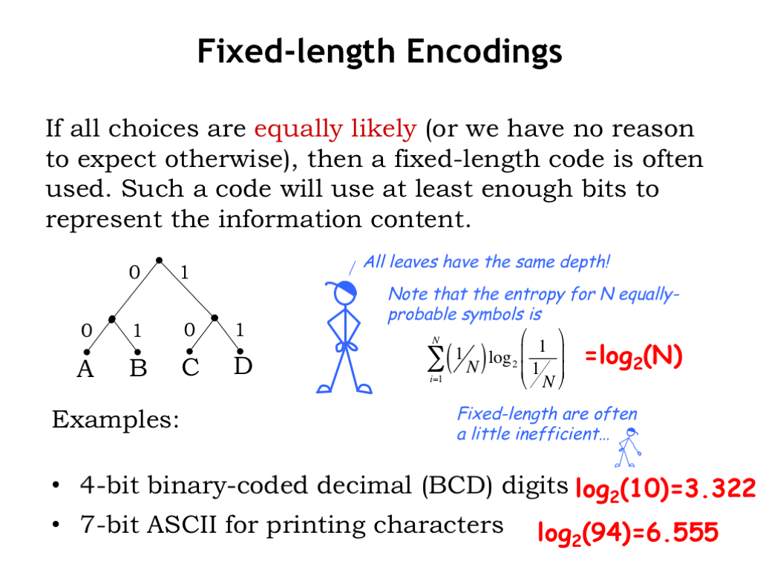
Lecture
SLIDE 4 / 14
Concept of Prefix-Free Codes
1
Prefix-free codes ensure no code is a prefix of another code.
2
This property allows unambiguous decoding without delimiters between symbols.
3
Fixed-length codes waste space for frequent characters in data.
4
Variable-length codes assign shorter bits to frequent characters.
5
Huffman coding creates an optimal prefix-free binary code set.
6
The resulting tree structure guarantees unique decodability for any stream.
1.1 Annotated Slides | Computation Structures | Electrical Engineering and Computer Science | MIT OpenCourseWare
Chandigarh University
4 / 14
Notes:
Imagine decoding a stream of bits without knowing where one character ends and another begins. If 'A' is 0 and 'B' is 01, the sequence 01 could be 'AB' or 'B'. Prefix-free codes prevent this ambiguity. Huffman coding ensures that no code is a prefix of another, solving this problem perfectly.

Slide 5
Lecture
SLIDE 5 / 14
Greedy Strategy for Construction
1
The algorithm uses a greedy approach to minimize total weighted path length.
2
It repeatedly combines the two nodes with the lowest frequencies.
3
A new internal node is created with frequency equal to the sum.
4
This process continues until a single root node remains in the tree.
5
The resulting tree is a full binary tree with leaves as characters.
6
This greedy choice property ensures the global optimum for the data.
Chandigarh University
5 / 14
Notes:
We use a greedy strategy because combining the two smallest frequencies locally leads to the best global result. Think of it like merging the lightest weights first to build a balanced structure. Each step reduces the problem size while maintaining the optimality condition for the remaining characters.

Slide 6
Lecture
SLIDE 6 / 14
Algorithm Steps Overview
1
Initialize a priority queue with all characters and their frequencies.
2
Extract the two nodes with the minimum frequency values from the queue.
3
Create a new internal node with these two as left and right children.
4
Assign the sum of frequencies to the new internal node.
5
Insert the new node back into the priority queue.
6
Repeat until the queue contains only one node, which becomes the root.
Chandigarh University
6 / 14
Notes:
The algorithm starts by placing all characters into a priority queue sorted by frequency. We then extract the two smallest, merge them, and put the sum back. This loop continues until only one node remains, which serves as the root of our final Huffman tree.

Slide 7
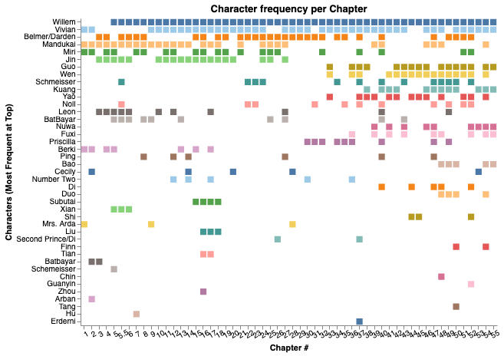
Worked Example
SLIDE 7 / 14
Input Data
GOVERNING EQUATION
Frequencies are: A=5, B=9, C=12, D=13, E=16
CONSIDER A TEXT WITH CHARACTERS
A, B, C, D, E.
• Total frequency sum is 55, representing total bits needed for raw data.
• We sort these characters in ascending order of their frequencies initially.
• The goal is to assign shorter codes to higher frequency characters.
• This example demonstrates the manual construction of the Huffman tree.
Source: preview.redd.it
Chandigarh University
7 / 14
Notes:
Let us work through a concrete example with five characters. We have frequencies ranging from 5 to 16. Notice that 'A' is the least frequent and 'E' is the most frequent. Our goal is to give 'E' a short code and 'A' a longer one to minimize total bits.

Slide 8
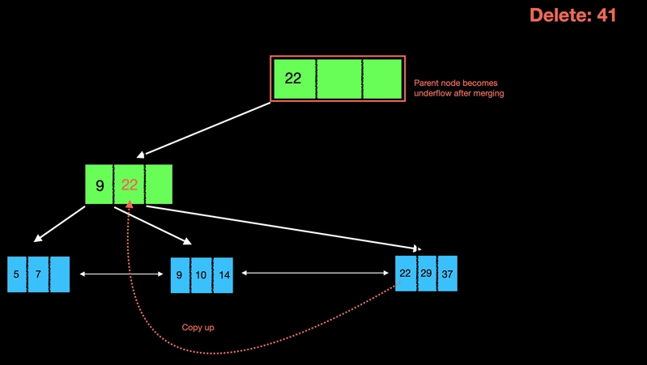
Step 1
SLIDE 8 / 14
Initial Merging
GOVERNING EQUATION
Create a new internal node with frequency 5 + 9 = 14
THE UPDATED LIST NOW CONTAINS
C(12), D(13), E(16), New(14).
• Select the two nodes with lowest frequencies: A(5) and B(9).
• Assign A as the left child and B as the right child.
• Insert the new node (14) back into the sorted list of nodes.
• Re-sort the list to maintain the priority queue order for next step.
Source: media2.dev.to
Chandigarh University
8 / 14
Notes:
First, we pick A and B because they are the smallest. We merge them into a parent node with frequency 14. This new node is now treated as a single unit in our queue. We re-sort the list to see the next smallest pair for the subsequent merge.

Slide 9
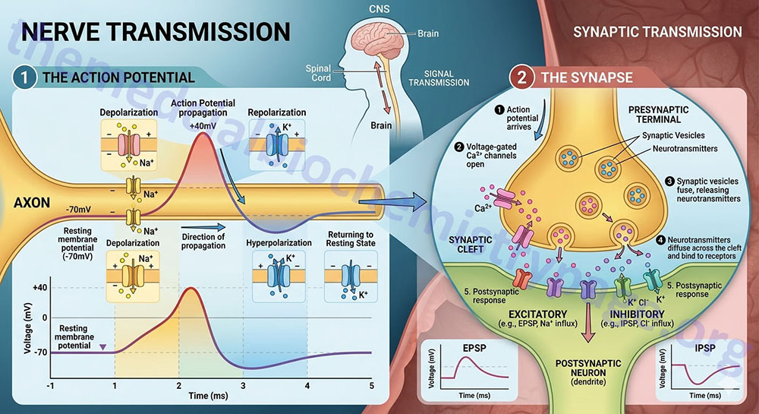
Step 2
SLIDE 9 / 14
Second Merging
GOVERNING EQUATION
Create a new internal node with frequency 12 + 13 = 25
SELECT THE TWO LOWEST NODES
C(12) and D(13).
THE UPDATED LIST NOW CONTAINS
E(16), New1(14), New2(25).
• Assign C as the left child and D as the right child.
• Insert the new node (25) back into the sorted list.
• Re-sort the list to identify the next pair for merging.
Source: themedicalbiochemistrypage.org
Chandigarh University
9 / 14
Notes:
Next, we take C and D, the next smallest available nodes. Their sum is 25. We create a new parent node for them. Now our queue has three items: E(16), the first merged node(14), and this new node(25). We must sort them again to proceed.

Slide 10
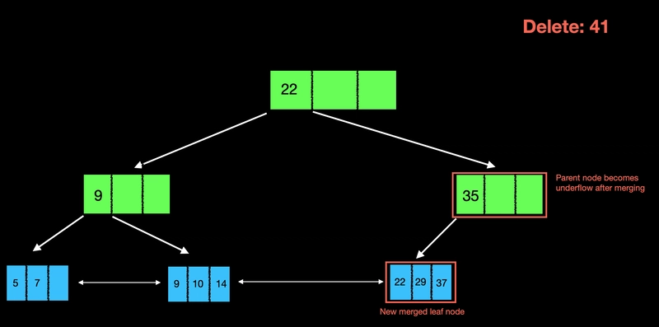
Step 3
SLIDE 10 / 14
Third Merging
GOVERNING EQUATION
Create a new internal node with frequency 16 + 14 = 30
SELECT THE TWO LOWEST NODES
E(16) and New1(14).
THE UPDATED LIST NOW CONTAINS
New2(25), New3(30).
• Assign New1 as the left child and E as the right child.
• Insert the new node (30) back into the sorted list.
• Only two nodes remain, so the next step will form the root.
Source: media2.dev.to
Chandigarh University
10 / 14
Notes:
Now we merge E(16) with the first merged node(14). Their sum is 30. This creates a larger subtree containing A, B, and E. We now have two large subtrees left: one with sum 25 and one with sum 30. These are the final two to merge.

Slide 11
Step 4
SLIDE 11 / 14
Final Root Formation
GOVERNING EQUATION
Create the root node with frequency 25 + 30 = 55
SELECT THE LAST TWO NODES
New2(25) and New3(30).
• Assign New2 as the left child and New3 as the right child.
• The priority queue is now empty, and the tree is complete.
• The root node represents the total frequency of all characters.
• The tree structure is now ready for code assignment.
Chandigarh University
11 / 14
Notes:
Finally, we merge the last two subtrees to form the root. The root has a frequency of 55, which matches our total input. The tree is now complete. Every character is a leaf node, and every internal node represents the sum of its children's frequencies.

Slide 12
Lecture
SLIDE 12 / 14
Code Assignment and Decoding
GOVERNING EQUATION
Example codes: A=000, B=001, C=010, D=011, E=10
1
Traverse from root to each leaf to assign binary codes.
2
Assign '0' for every left branch and '1' for every right branch.
3
The code for a character is the sequence of bits along the path.
4
Decoding is performed by traversing the tree from the root.
5
Reaching a leaf node signifies the end of a character code.
Chandigarh University
12 / 14
Notes:
To get the codes, we traverse from the root. Going left adds a '0', going right adds a '1'. For example, 'E' might be '10' while 'A' is '000'. This ensures that '10' is not a prefix of '000'. Decoding simply follows the path until a leaf is reached.

Slide 13
Lecture
SLIDE 13 / 14
Key Takeaways
1
Huffman coding generates optimal prefix-free binary codes for data.
2
The greedy algorithm builds the tree by merging lowest frequency nodes.
3
Frequent characters receive shorter codes, reducing total transmission size.
4
The tree structure ensures unambiguous decoding of the bitstream.
5
This method is widely used in file compression and transmission protocols.
Chandigarh University
13 / 14
Notes:
To summarize, Huffman coding creates the most efficient variable-length codes possible for a given set of frequencies. The greedy approach guarantees optimality by always merging the smallest weights. This results in significant space savings for data transmission and storage.

Slide 14
Lecture
SLIDE 14 / 14
References
DATA STRUCTURES
A Pseudocode Approach with C — Gilberg, Forouzan
• Data Structures — Lipschutz
• Data Structure Using C — AK Sharma
• C and Data structure — P. S. Deshpandey
Chandigarh University
14 / 14
Notes:
For further reading, please refer to the standard texts listed here. Gilberg and Forouzan provide excellent pseudocode approaches. Lipschutz and Sharma offer deep insights into C implementations. Deshpandey is also a valuable resource for practical data structure applications.

